Slide 1


Smart Budget June 29, 2023
Notes:
Abdullah

Slide 2
Our Team
Kamaluddin Shamsi
Brian Le
Brian Quach
Product Owner
Scrum Master
Scrum Master
Dang Khoa Le
Akshayraj Jeripotula
Abdullah Riaz
Team Member
Team Member
Team Member
Notes:
Abdullah

Slide 3
Purpose
Problem:
Users lack a means of simple and effortless financial monitoring to track personal income and expenses.
Opportunity:
Provide the client with a comprehensive and user-friendly solution to promote smart personal finance management.
Beneficiaries:
Anyone seeking to centralize their finances to accomplish financial goals.
How it Helps:
Users will be empowered to take control of their finances and analyze their spending habits to make well informed decisions and ultimately increase their financial literacy.
Notes:
Brian Le

Slide 4
Project Scope
Security
Income
Budget
Planning
Notify
Security
Be able to handle user authentication and edit user profiles (1)
Be able to add income and expenses (2)
Be able to create a budget (3)
Be able to create saving goals (4)
Be able to notify about upcoming bills (email, etc) (5)
Be able to ensure customer information remains private (6)
Notes:
Brian Le

Slide 5
Sprint 1
(1) As a user, I want to be able to create a profile so that I can store my information. [1]
(1) As a user, I want to login easily, so that I can access my budget information. [8]
Spikes
Research on Node.js, Express, and React frameworks
Research on basic UI and server API
Infrastructure
Download required npm packages
Set up Git branches
Notes:
Kamal S

Slide 6
Sprint 2
(2) As a user, I want to be able to add/view income and expense information so that I can keep track of my expenses. [5]
(3) As a user, I want to be able to set a budget, so it helps me to not overspend my monthly limit. [13]
(4) As a user, I want to be able to set saving goals, so I have a vision on what I am working for. [2]
Spikes
Research on income and Expense tracking best practices
Infrastructure
Implement API endpoints and database schema for income and expenses
Develop budget logic and tracking
Design user interface components for managing saving goals
Notes:
Kamal S

Slide 7
Sprint 3
(5)As a user, I want to be notified of my billing deadlines, so that I can avoid late fee expenses. [3]
(6)As a user, I want my information to be secure and private so that my information doesn’t get stolen. [34]
Spikes
Research and implementation of notification strategies
Infrastructure
Enhance backend with notification functionality
Implement Security measures like encryption and access control
Notes:
Kamal S

Slide 8
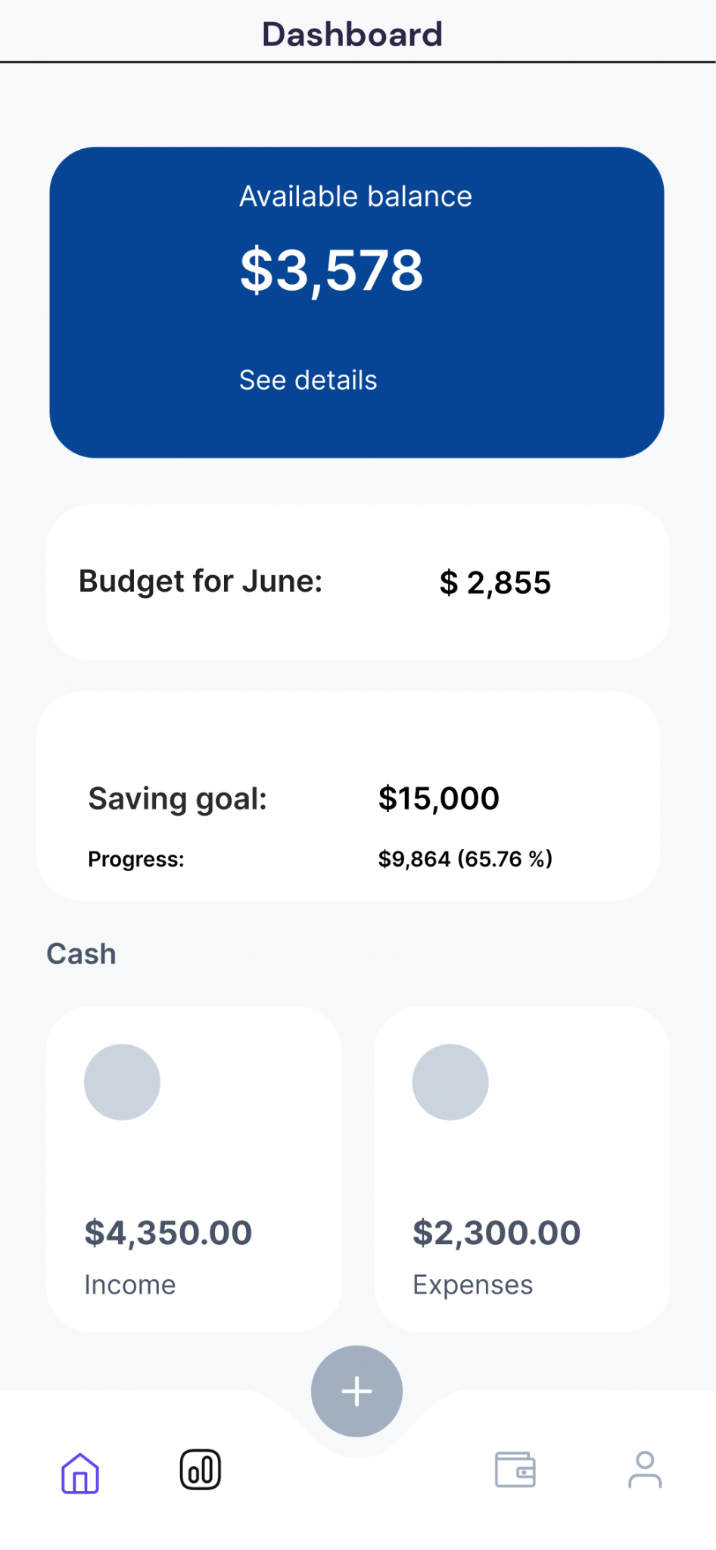
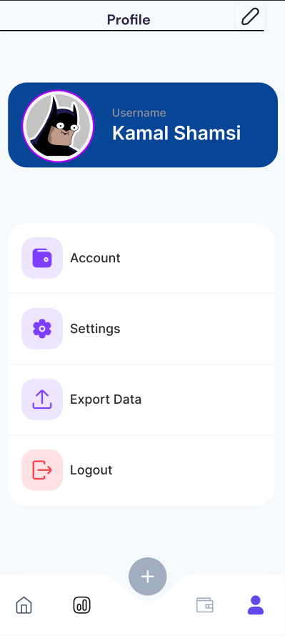
Notes:
Kamal S

Slide 9
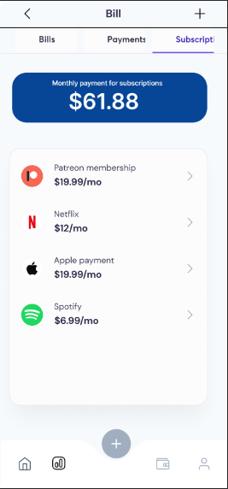
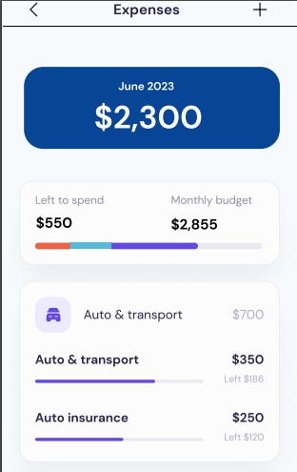
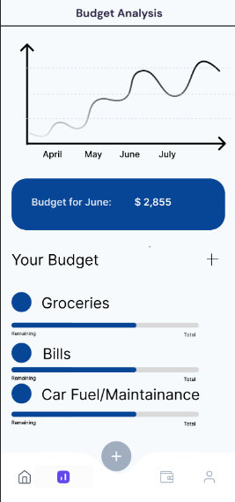
Notes:
Kamal S

Slide 10
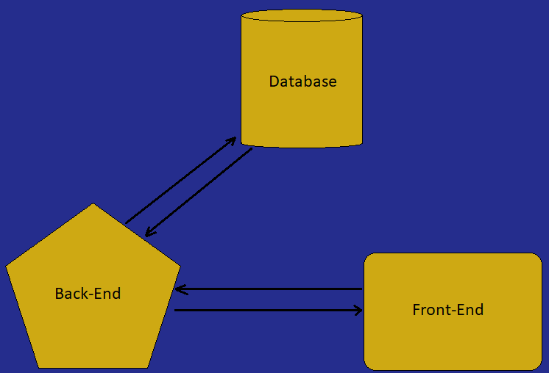
Architecture
Frontend: Includes login, dashboard, income/expense tracker, budget creator, saving goals section, and notifications.
Backend: Handles authentication, user profile, income/expense, budget, savings goals management, and notifications.
Database: Stores all user data, including profiles, income/expense records, budgets, and saving goals.
Notes:
Khoa Le

Slide 11
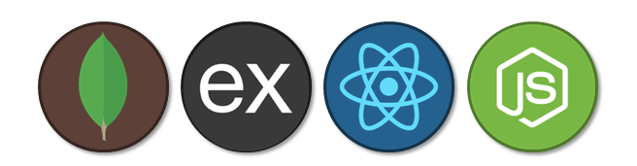
Technologies
Frontend
- JavaScript w/React.js
- Redux (state manager)
- CSS-in-JS (style)
- React Router
- NPM/Yarn (package manager)
- Bootstrap, Material UI
Back-End Technologies:
- Node.js w/Express.js
- MongoDB/PostgreSQL (database)
- Passport.js (authenticator)
- Express-session (session manager)
Other Tech
- Git for version control
- Axios for HTTP requests
- Visual Studio Code for code editing
- Docker for deployment
Notes:
Kamal Shamsi

Slide 12
Challenges/Risks
[Challenge/Risk 1] Unfamiliar Technologies: As we use new technologies and tools for this project, we may encounter a learning curve that could potentially slow down our development process.
[Challenge/Risk 2] Complex Feature Set: The implementation of various features such as secure authentication, budget analyses and saving goals could pose a challenge due to their complexity.
[Challenge/Risk 3]
Data Security: Ensuring the protection of user data is crucial. This task might be difficult, as we need to familiarize ourselves with best security practices and encryption methods.
[Challenge/Risk 4] Time Constraints: Given that this is a college project, we might face constraints in terms of deadlines. The limited time could make it challenging to accomplish all our project goals.
Notes:
Akshay

Slide 13
Minimum Viable Product (MVP)
To consider the Smart Budget project a success, the minimum functionality includes
Creating user profiles (User Story 1.1)
Secure login (User Story 1.2)
Allow users to add and view income and expenses (User Story 2.1)
Set a personal budget (User Story 2.2)
Define saving goals (User Story 2.3)
Provide billing notifications (User Story 3.1)
Ensure user information is secure and private (User Story 3.2)
Notes:
Brian Quach

Slide 14
Questions?

